Slide 1
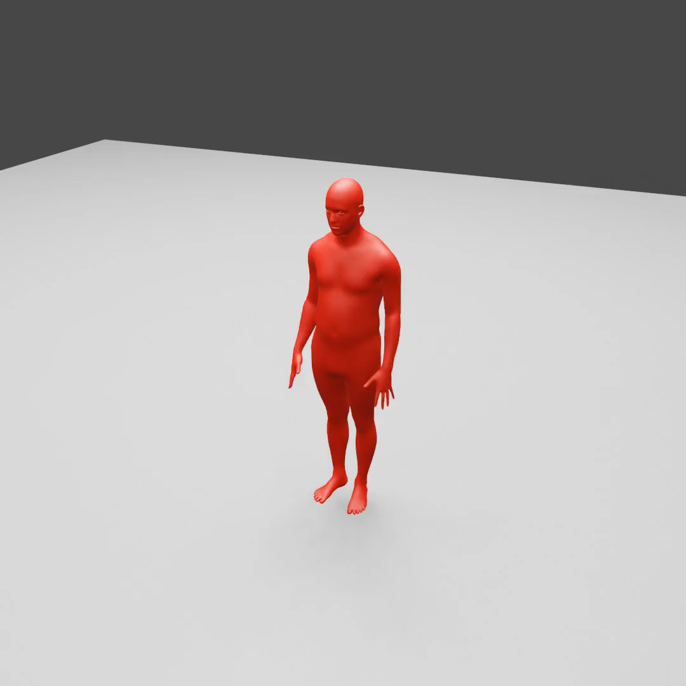
Online text-to-motion
Text prompt sequence:
Wave hands
Walk forward
cartwheel
Walk forward
Turn left
Sit down
Stand up
Hop on left leg
Pace in circle
Dance
Stand
Wave right hand
(Moving camera, colors denote actions)
Notes:
DART enables generating high quality complex activity sequences from text prompts in real time.

Slide 2
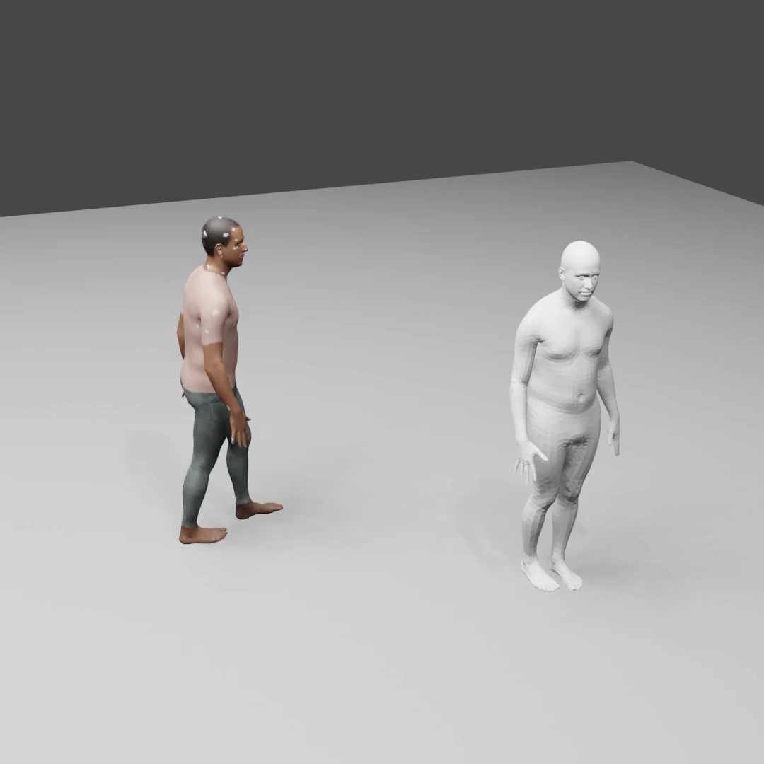
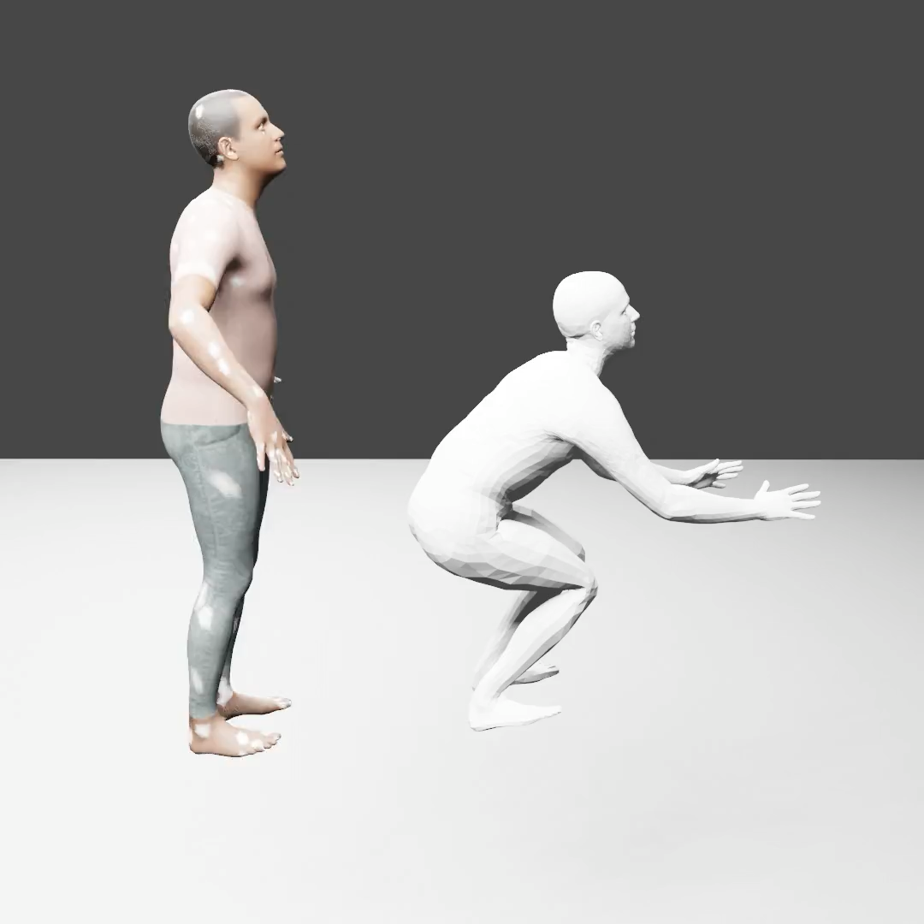
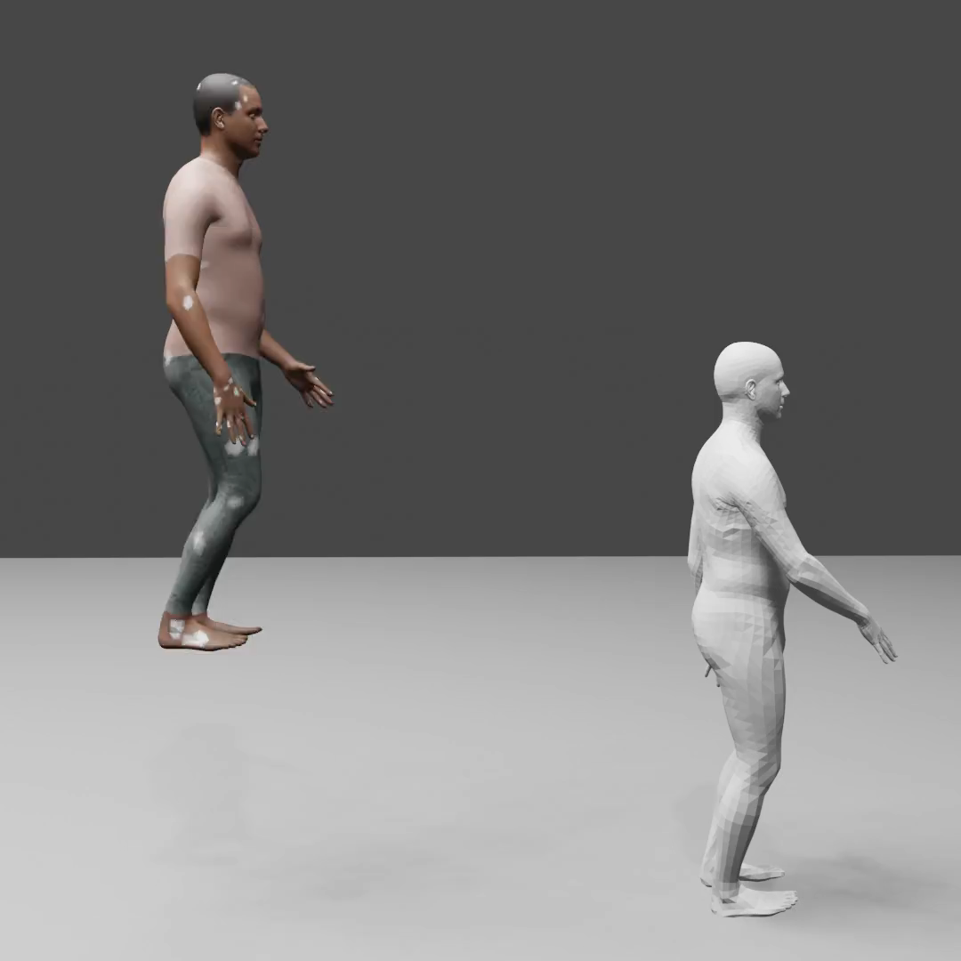
Text-conditioned in-betweening
“Walk”
“Jump forward”
“Walk downstairs”
Notes:
Given 2 frames seed motion and goal key frame, using DART with latent diffusion noise optimization can naturally infill the middle frames guided by the text.

Slide 3
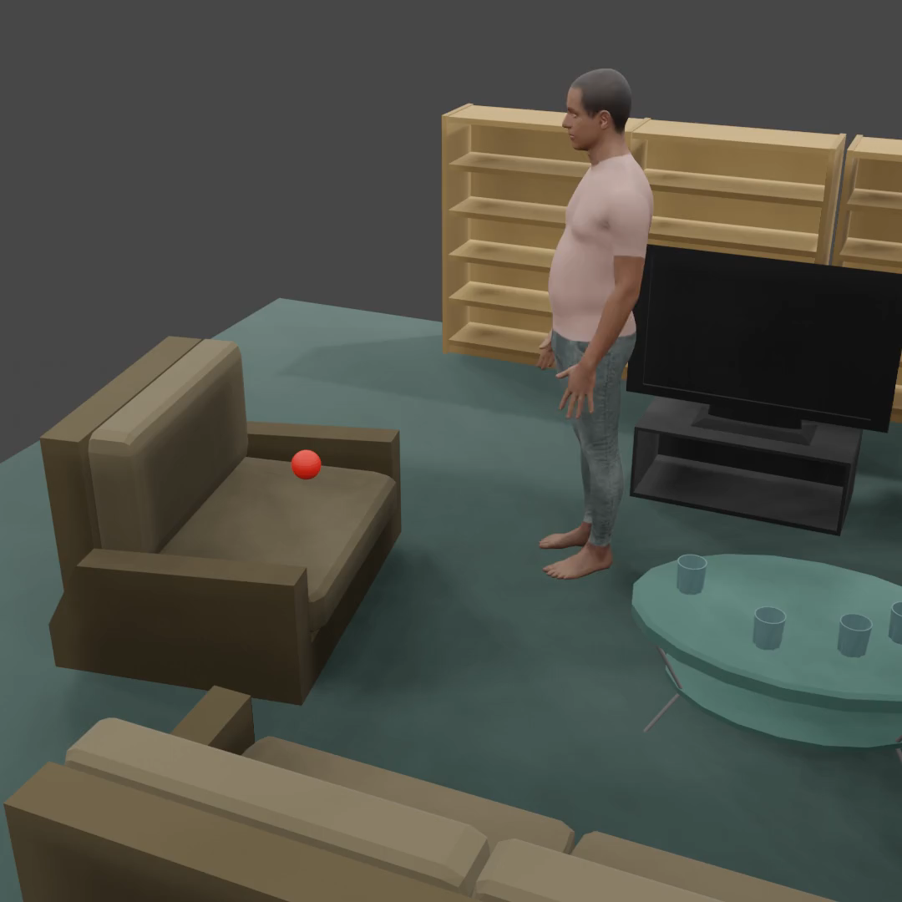
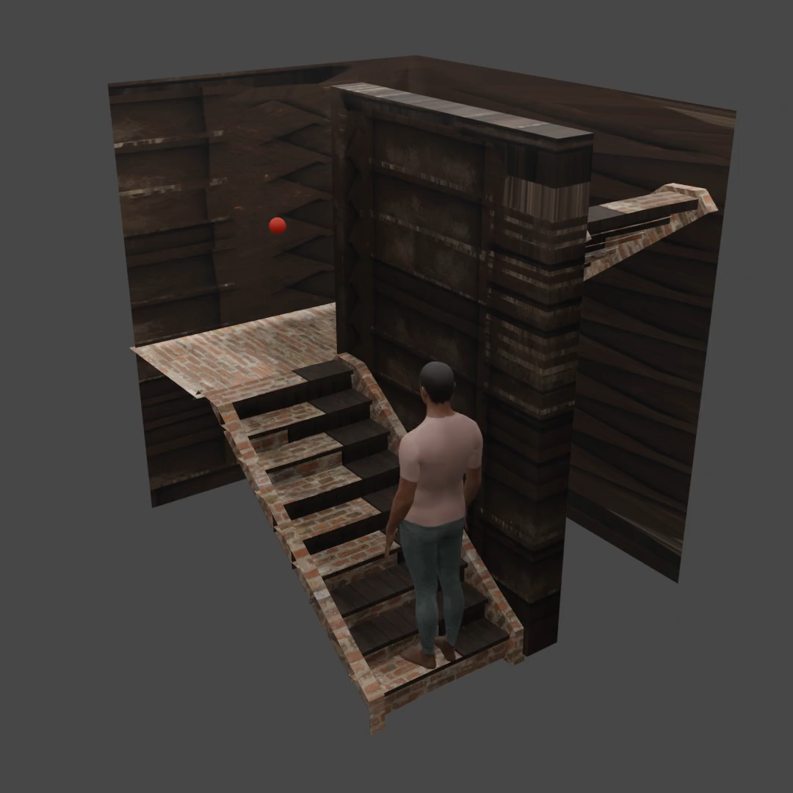
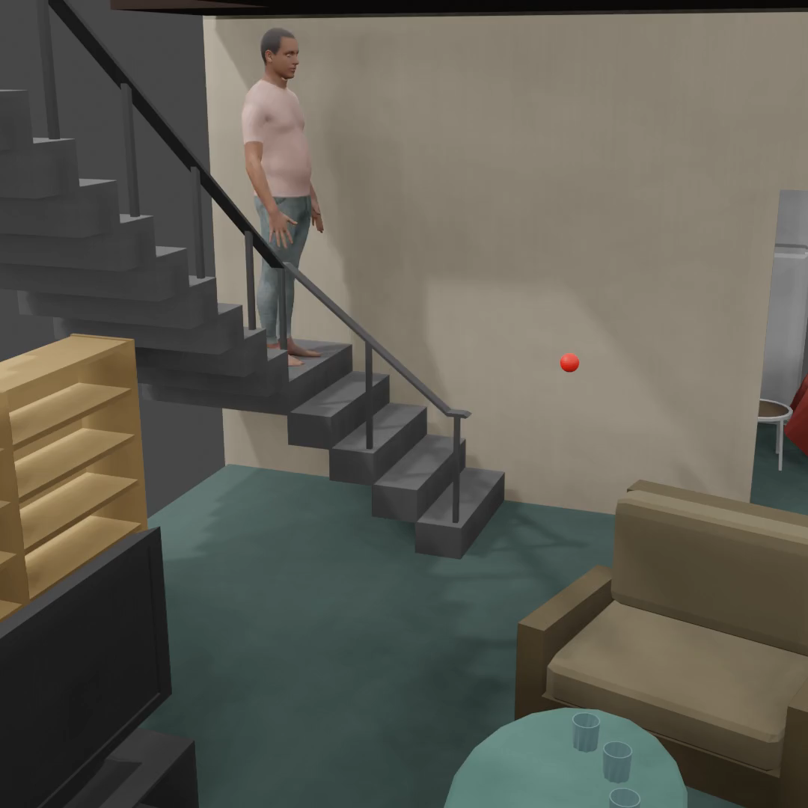
Human-scene Interaction
“Walk – turn left – sit on the chair”
“Walk upstairs”
“Walk downstairs”
Red sphere: goal pelvis location
Scene assets: Objaverse [Deitke et al., CVPR’23]
Notes:
Moreover, we demonstrate that scene context can be incorporated into our optimization-based control to synthesize human-scene interactions.
Given a target pelvis location, a 3D scene, and text prompts, our method evaluates human-scene contact and penetration metrics during optimization to generate plausible human interactions with 3D scenes. The generated human can achieve the specified interactions while adhering to the scene and physical constraints.

Slide 4
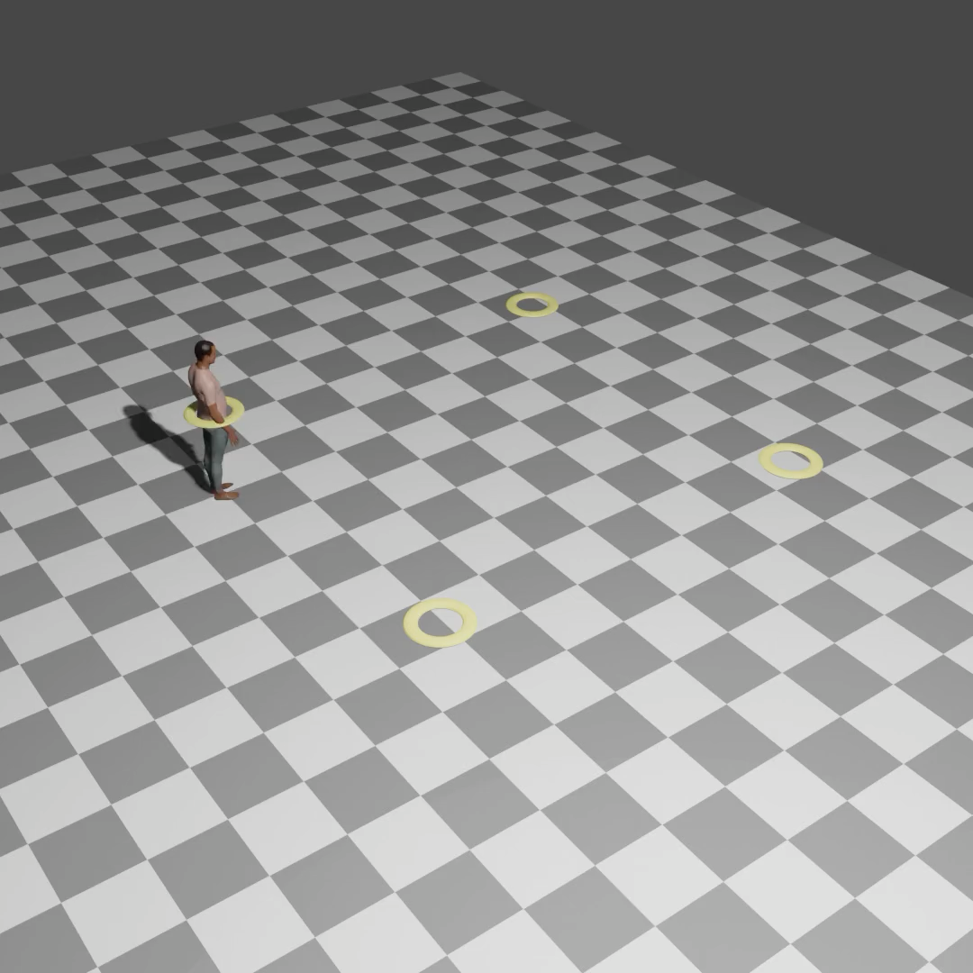


Text-conditioned goal reaching
“walk”
“run”
“hop on the left leg”
Yellow torus: goal waypoints
Notes:
We instantiate the RL-based control on the task of text-conditioned goal reaching task, where the human needs to reach dynamically updating waypoints using the prompted locomotion skills.
Our trained policy model effectively controls the human motion to reach dynamic waypoints while adhering to the text prompt semantics, generating approximately 240 frames per second in real time.

